Slide 1
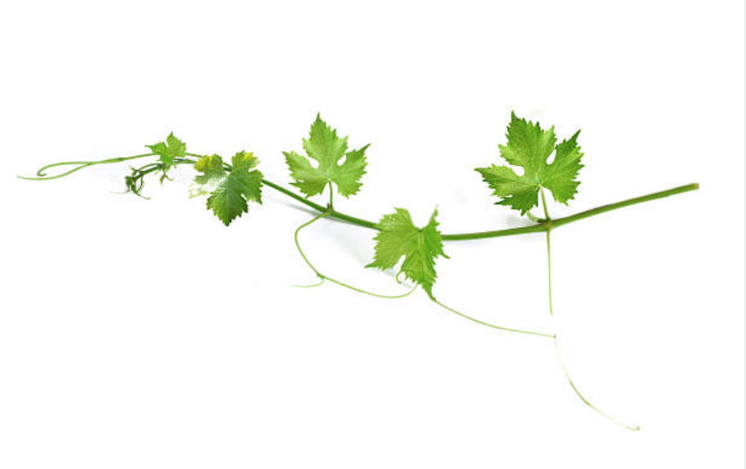

- Testing -
pH & Free SO2

Slide 2

Notes:
Steve Schmidt, a former MWS member, told me when I first started that some approached winemaking from a more “science-like” perspective, and others took a more “artistic” approach. He went on to say that…
Over the years as we have had guest winemakers from local wineries, I have noticed a “bent” toward one side of the other out of most of them. I think I have listened to two who seemed to have a real balance to them in that they approached things from both sides. I’ve always been personally attracted to that.
I suppose I probably prefer to think of myself in more of the “creative” vein, though if I am to be honest, it’s probably because I like the sound of the word creative more than I like the words “lazy” and “undisciplined”, though those are probably closer to the truth.
I enjoy the science side of this because I like to control things, and if I stumble upon something good I want to be able to repeat it. But I seem to lack the discipline to do it consistently. It occurred to me when Phil asked me to do this presentation that for those of you that are more on the science side, this is unnecessary because you already do this stuff. But for those of you that may lean toward the artistic side, or simply be lazy like me, it could be something important that you are missing and is holding you back. Driveway stains…,

Slide 3

/
“Presentation” of your wine
Selecting a “target style” for your wine
To cold soak, or not?
Which additives to use?
To add oak; what kind, for how long?
Determining your desired pH and TA
Following a recipe vs. winging it
Bench-test blending vs. Pearson’s Square
Selection of trellis type & exposure to sun
How many grape bunches to allow
When to harvest
But however much you tend toward the
“creative” side, I would suggest you at
least be consistent with testing for
pH and Free SO2

Slide 4

Why test pH and Free SO2?
create a balanced wine
avoid spoilage

Slide 5
Importance of pH
At lower pH, red wines are redder, fresher, fruitier, younger tasting for their age, slower to age, slower to mature, less complex, less full-bodied, much slower to spoil, and easier to maintain free of spoilage in the cellar because the SO2 is more active at the lower pH.
Higher pH wines, if they are red, are less red (sometimes brown, sometimes purple), less fresh, less fruity, more complex, more full-bodied, faster to age, faster to mature, easier to spoil, and more difficult to manage in the cellar with SO2.
Source: Techniques In Home Winemaking, Daniel Pambianchi

Slide 6
Understanding pH
PH is a close relative of acidity, specifically total titratable acidity (TA) for wines. TA measures the acid concentration in musts and wines while pH measures the relative strength of those acids.
Two wines with similar TA measurements but different pH will be very different and will evolve differently. A wine with a lower pH may show redder color (in the case of red wines) with greater stability during aging, and will have more fruit and less complexity and body than a higher pH wine.
A low-pH wine will taste tart, owing to the higher acid concentration. Conversely, a high-pH wine will taste flat and lack freshness. A high pH wine will also tend to oxidize faster and therefore not age as well.
Source: Techniques In Home Winemaking, Daniel Pambianchi

Slide 7
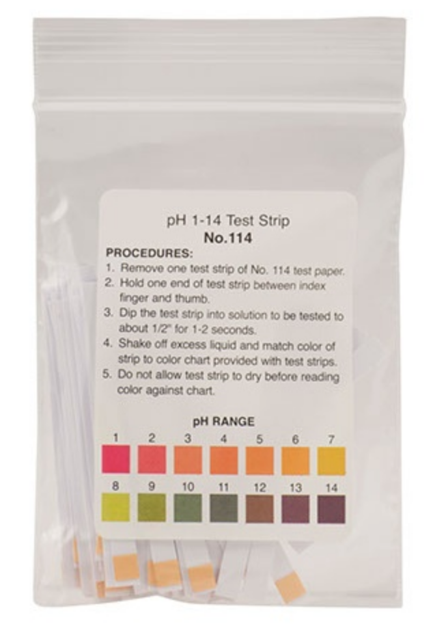
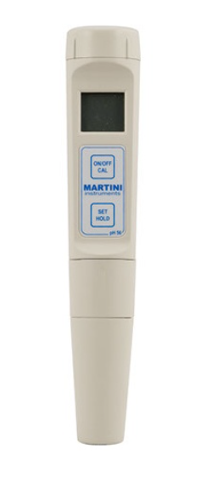
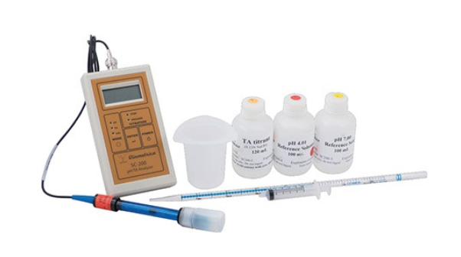
Measuring the pH level
pH paper
pH meter

Slide 8
Testing the pH level and adjusting/correcting the pH
Calibrate meter and take a reading
Correct the pH if needed
To lower the pH, add tartaric acid crystals at a rate of 1g per liter of wine to lower the pH by 0.1 unit.
To raise the pH, add potassium bicarbonate at a rate of 1g per liter of wine to raise the pH by 0.1 unit.
Tip: It might be wise to “sneak up on” changes by using
less than the formula calls for. It is easy to over-shoot.
Source: Techniques In Home Winemaking, Daniel Pambianchi

Slide 9
Recommended TA and pH ranges for different types of must and wine
Type of wine | TA range for must (g/L) | TA range for wine (g/L) | pH range for must and wine
Dry white | 7.0 – 9.0 | 5.0 – 7.5 | 3.1 – 3.4
Dry red | 6.0 – 8.0 | 4.0 – 5.5 | 3.3 – 3.6
Sweet white | 7.5 – 9.0 | 5.5 – 7.5 | 3.1 – 3.2
Source: Techniques In Home Winemaking, Daniel Pambianchi

Slide 10
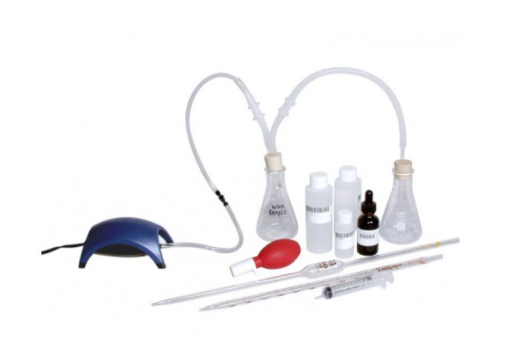
Free SO2 testing
Multiple methods; Ripper Method
Aeration-Oxidation System
Vinmetrica SC-300 SO2, pH & TA Analyzer
This demonstration will be with the Aeration-Oxidation System sold by MoreWine and others.

Slide 11

Begin The Free SO2 Test…
(queue my lovely assistant)
Sally

Slide 12
Free vs. bound SO2
With every addition of sulfite, some SO2 becomes active as free SO2, and some becomes bound. The sum is Total SO2; however only free SO2 has antioxidant and preservative properties.
Over time, due to oxidation and winemaking operations, such as racking, free SO2 becomes bound, and the sulfite’s effectiveness is diminished. Therefore it is critical to maintain a nominal level of free SO2, and frequent measurements, with subsequent adjustments, are necessary to reduce risk of spoilage.
A simple rule of thumb is to maintain a free SO2 level of ~35ppm in red wines and up to 50ppm in white wines.
Tip: Be sure to check the free SO2 more frequently than
you normally would when using a new oak barrel.
Source: Techniques In Home Winemaking, Daniel Pambianchi

Slide 13

Relationship issues:
pH and SO2
The higher the pH of your wine (low acidity), the less effective SO2 is. So don’t treat you wines all the same. Again, as pH increases, free SO2 effectiveness decreases, and more sulfite is required to protect the wine.
Source: Techniques In Home Winemaking, Daniel Pambianchi

Slide 14
Aeration-Oxidation System
Overview: In brief, the procedure involves adding an acid and then agitating a wine sample so that the Free SO2 gets driven off as a gas. By design, the only way for the gas to exit the system is to be passed through the second flask, which is filled with Hydrogen Peroxide and a colored indicator. As the gas passes through the solution, the Hydrogen Peroxide actually converts the SO2 to Sulfuric Acid. As a result of the change in pH from making the acid, the indicator changes color from gray-green to purple. Upon reaching the end-point of the test, you then neutralize the Sulfuric Acid you made with a base, Sodium Hydroxide (NaOH). Since all the acid was made from the SO2 in your wine sample, a simple calculation can relate the amount of NaOH that was needed to neutralize the acid to the amount of SO2 that was originally present in the wine sample.
Source: MoreWine Website

Slide 15
Aeration-Oxidation System
We are performing an actual test during this presentation, but if someone wants to watch a professional 3-part video of a test later, use this link:
https://morewinemaking.com/products/economy-aerationoxidation-free-so2-test-kit.html
Tip: As with everything that touches your fermented wine,
ensure your wine thief is clean when getting samples to
test, but use distilled water to rinse the sanitizing solution
off of your wine thief to avoid misleading results when
testing for SO2.

Slide 16
Misc. / Filler…
You should store the Hydrogen Peroxide tightly-sealed and in the refrigerator, but will need take it out and allow it to warm to room temperature before using it to run your tests. The strength of the Hydrogen Peroxide used in the procedure (3%) is more than adequate for the needs of the test, and it will remain effective around three months once opened.
The NaOH (Sodium Hydroxide) should be stored sealed and in the fridge as well, and also returned to room temp prior to use. This concentration of NaOH should keep for 3–4 months.
Source: MoreWine Website

Slide 17
Misc. / Filler…
To avoid any loss of gas in the system (and therefore lower the accuracy of the results), make sure all of the connections are tight.
A Laboratory Wash Bottle is very handy for cleaning out the flasks and your pipettes with distilled water.
Keep in mind that any 25% Phosphoric Acid left over on the pipette when you next use it for Hydrogen Peroxide will contaminate your bottle of peroxide and distort the results of the test. Therefore, it is best to designate, and mark, your pipettes for the purpose for which they will be used. Having two separate pipettes for acids and bases will also decrease the likelihood of cross-contaminating your solutions.
Source: MoreWine Website

Slide 18
Misc. / Filler…
Environmental concerns: While the small amount of Sulfuric Acid that you create during the test is neutralized at the end, the 25% Phosphoric Acid that you used to drive the SO2 out of the wine sample is not consumed at any point. This means that it is still present in the spent sample at the end of the test. For the benefit of the environment, it is suggested that you discard this sample in a plastic bucket and neutralize it with baking soda prior to putting it down the sink or toilet. You’ll be able to tell when it is safe to discard because the solution will turn green and stop foaming when you add baking soda once it is neutral.
Source: MoreWine Website

Slide 19
Checking the results of the Free SO2 Test…
(queue the lovely assistant
again)
Sally

Slide 20
Sulfite calculator
Winemaker magazine offers an online Free SO2 Calculator tool
https://winemakermag.com/1301-sulfite-calculator
This tool allows calculations depending on whether you use Sulfite Powder, Campden Tablets, or a 10% Sulfite Solution (my personal recommendation), and bases the recommendation on whether it is red or white wine, current pH, quantity of wine, current Free SO2, and temperature of the wine.
Tip: Freshen your 10% solution regularly. It can lose its’
potency if too old.

Slide 21
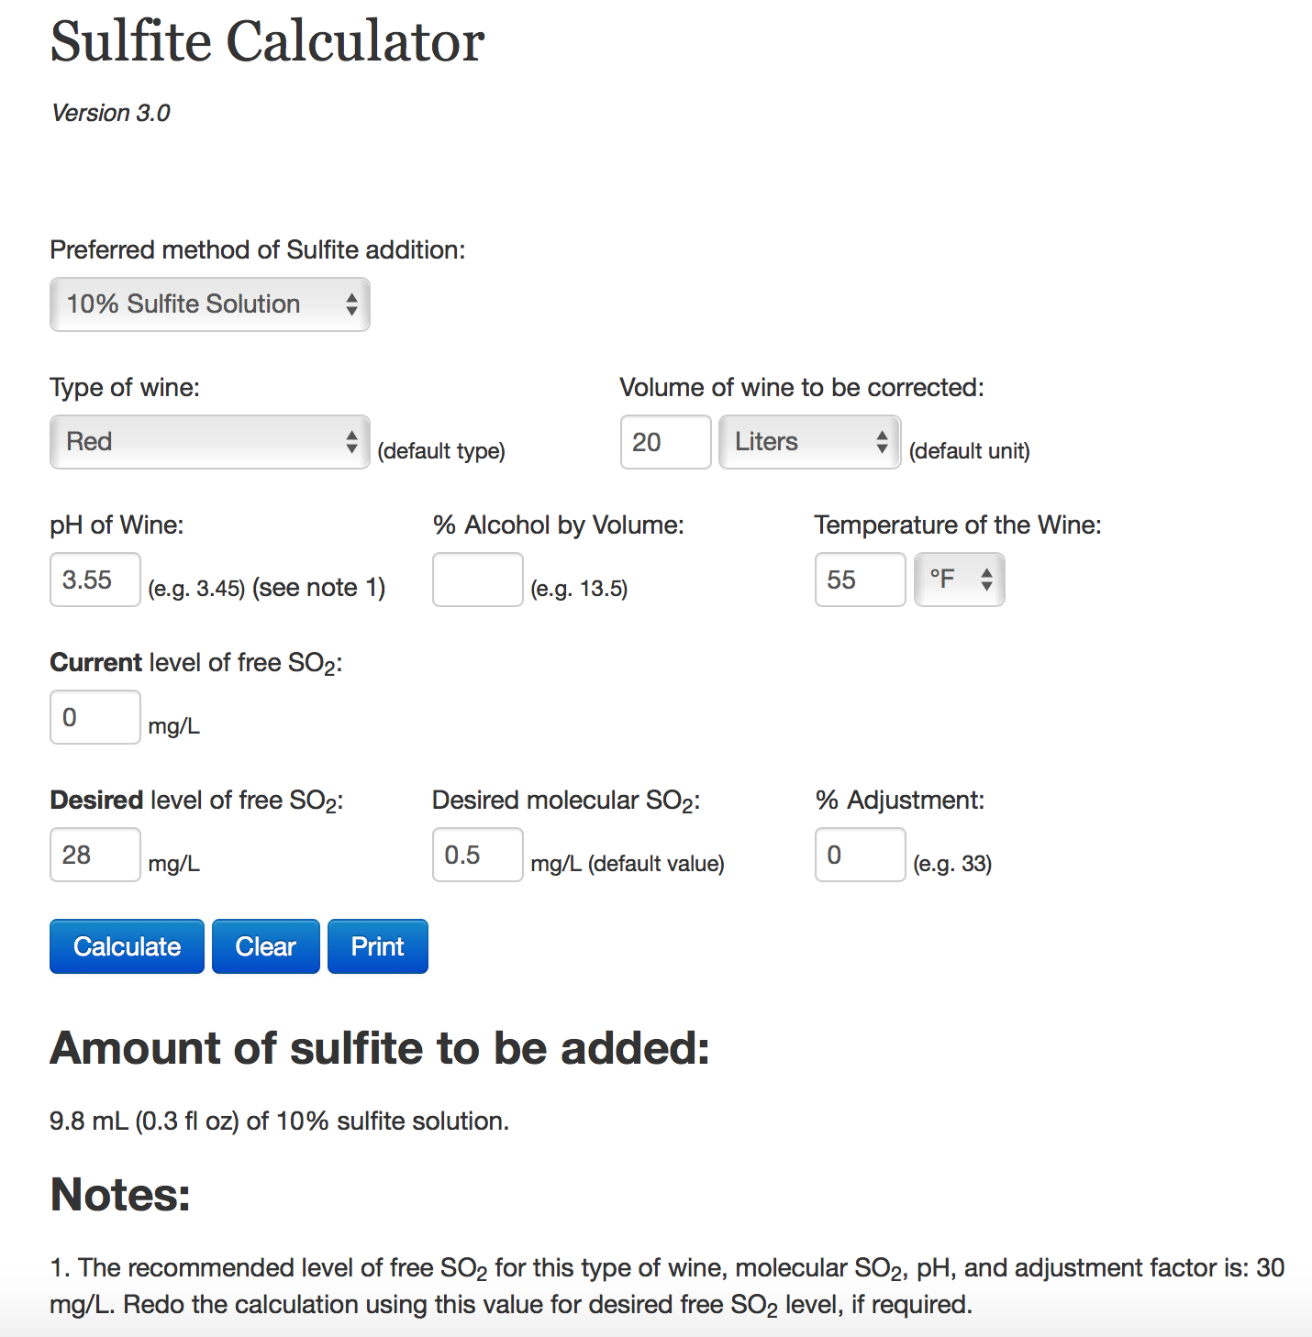
Tip: Clear the page between calculations or your results
may be inconsistent.

Slide 22

a’ ta santé

Slide 23


