Slide 1
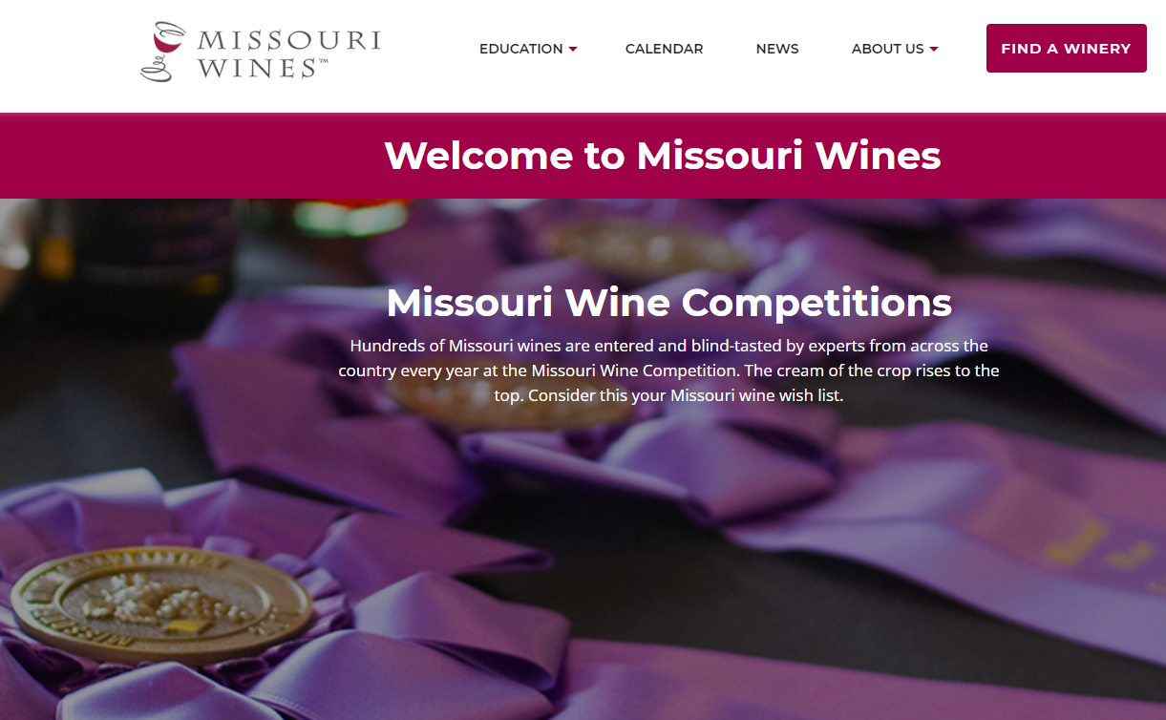
2023 Missouri Wines Gold Medal Winners www.missouriwine.org

Slide 2
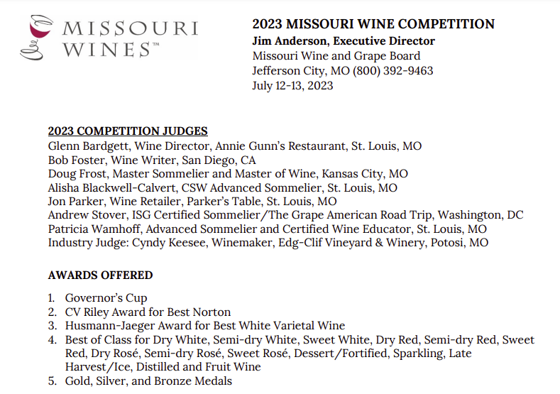

Slide 3
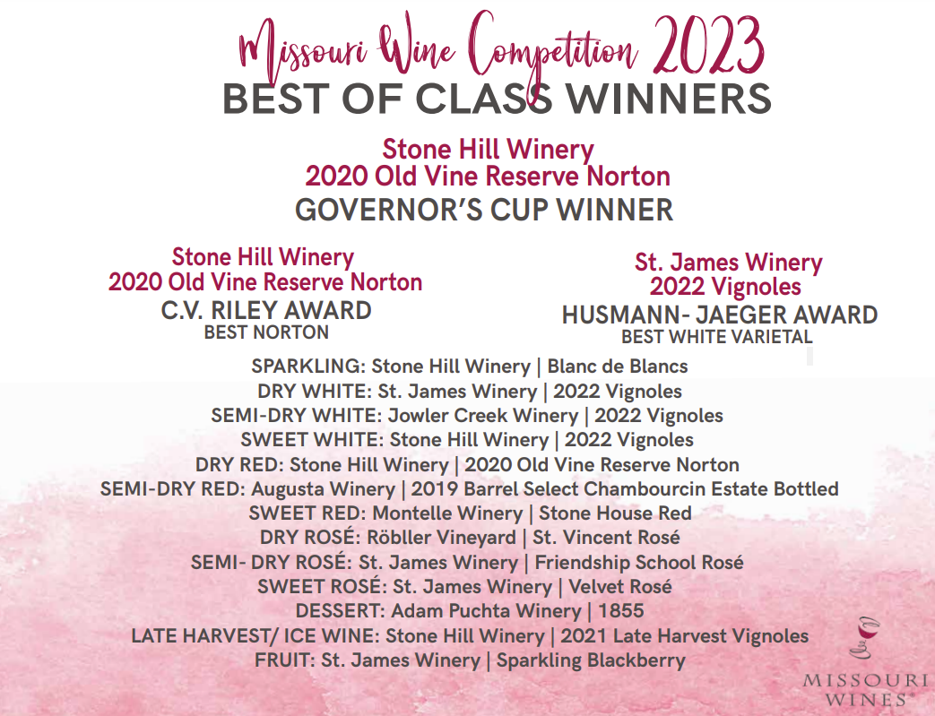

Slide 4
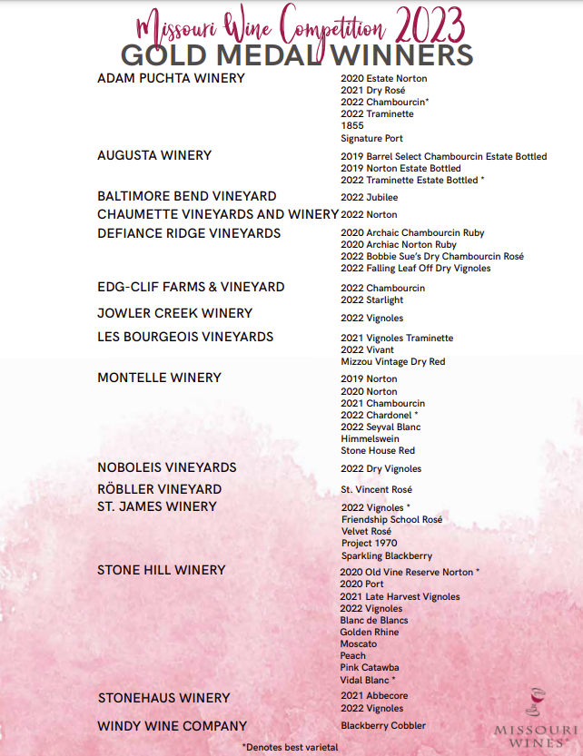

Slide 5
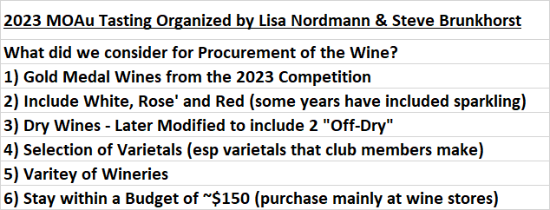
MWS GOLD MEDAL WINE TASTING PLANNING

Slide 6
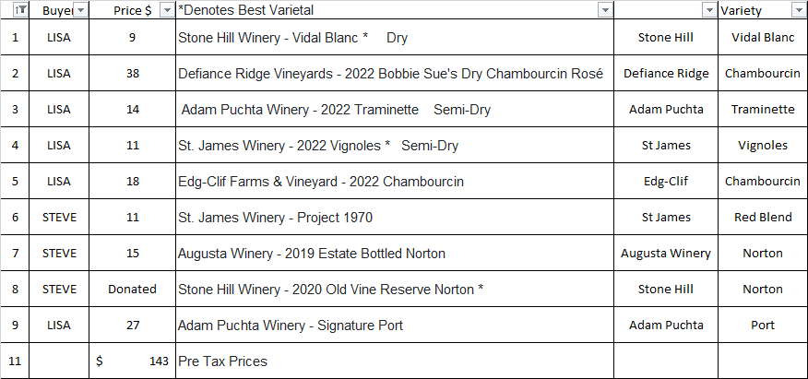
MWS GOLD MEDAL WINE TASTING SEQUENCE

Slide 8
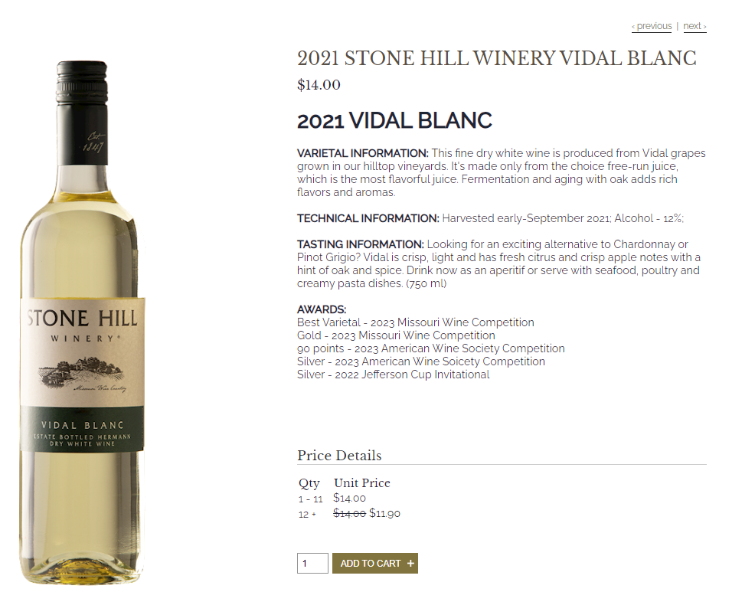

Slide 9
$9

Slide 10
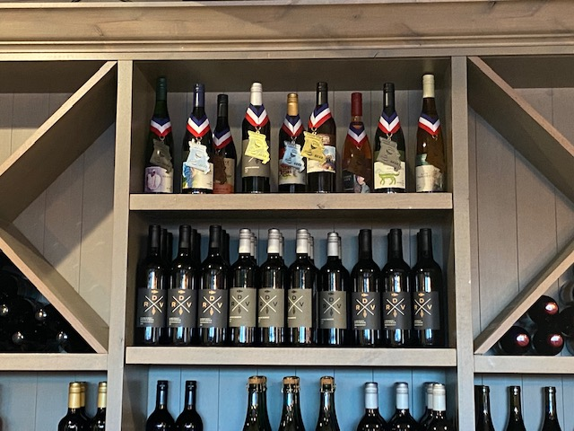
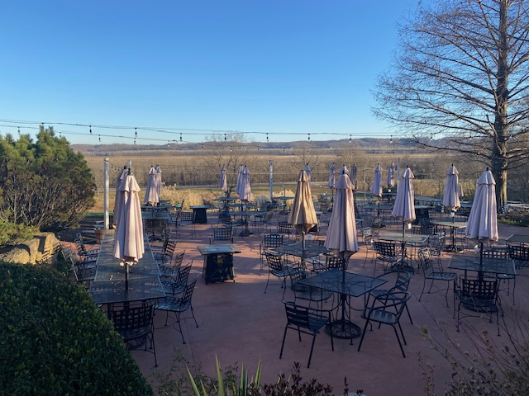
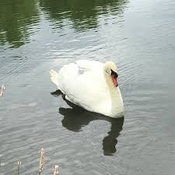
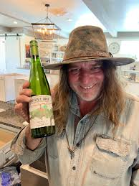
Defiance Ridge Vineyard

Slide 11
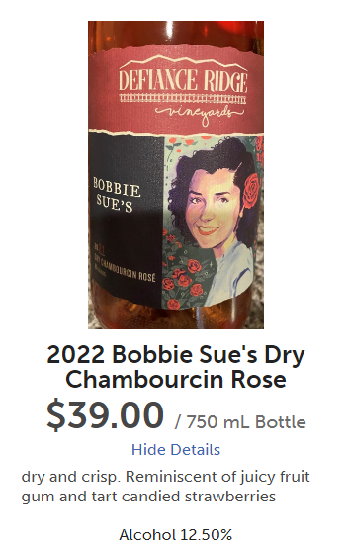
$39

Slide 12
$39

Slide 13
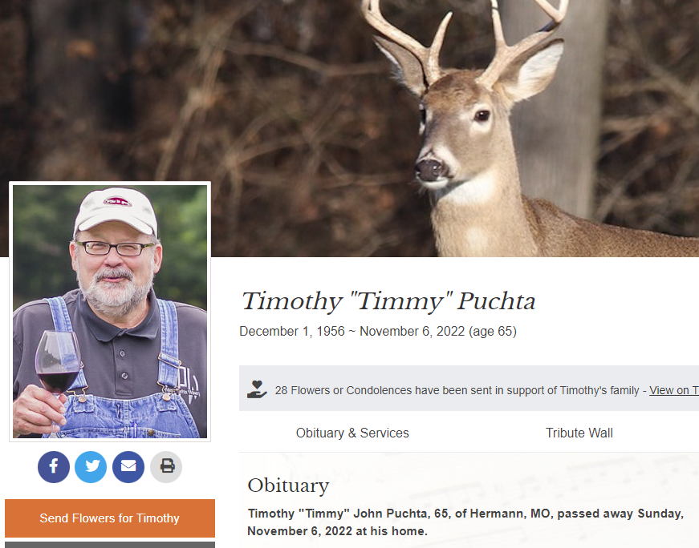
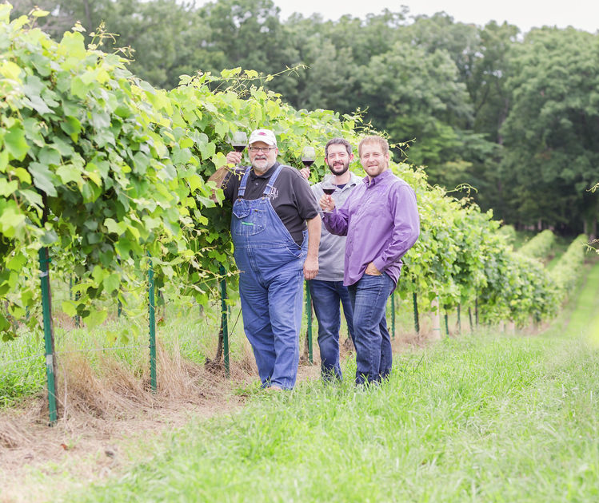
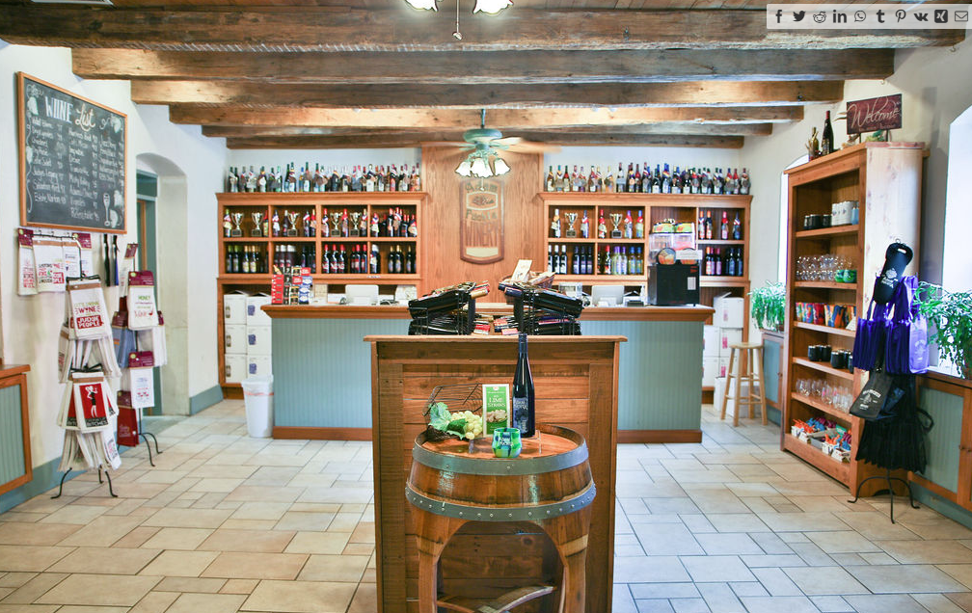
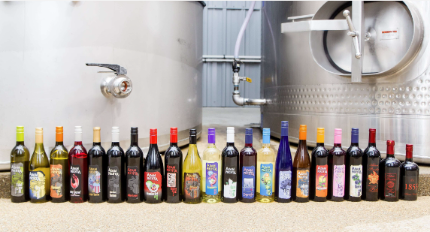
Adam Puchta Winery

Slide 14
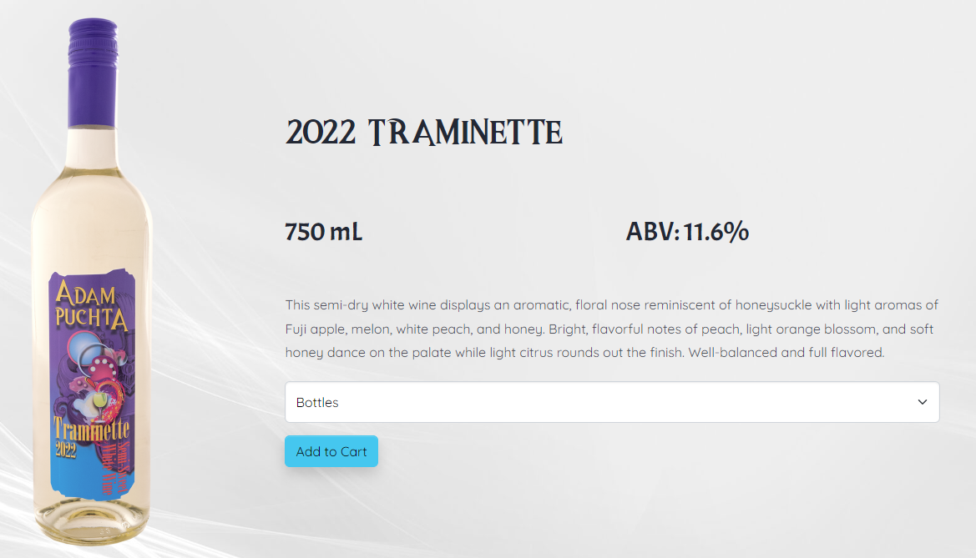
$14

Slide 15
$14

Slide 16
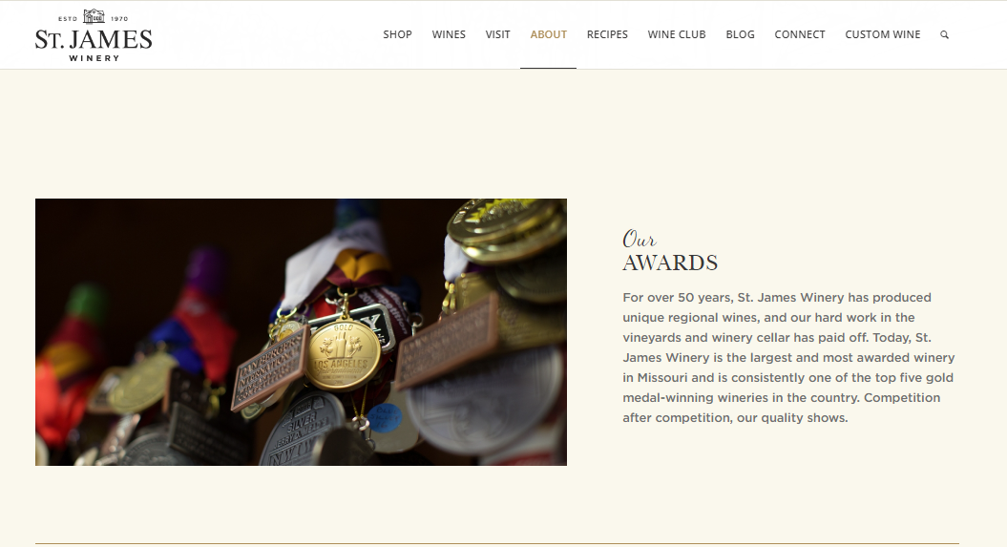

Slide 17
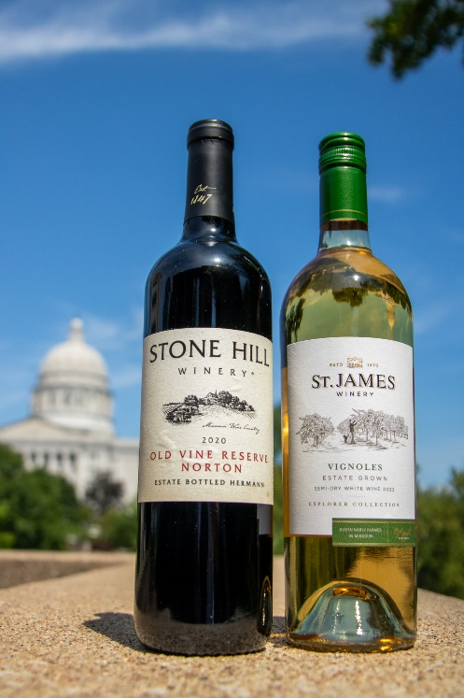
The Husmann-Jaeger award for best white varietal wine went to St. James Winery’s 2022 Vignoles. This is the first year this award is being presented and it is named after George Husmann and Hermann Jaeger. Both of these influential men were integral in the early development of the Missouri wine industry.
“We are honored to be recognized for the best white varietal wine in Missouri,” says Andrew Meggitt, St. James Winery Executive Winemaker. “Given the changes in our climate, our teams in the cellar and vineyard have been working hard to make adjustments to how we grow grapes and make wine. This award confirms that the changes we are making are increasing quality.”

Slide 18
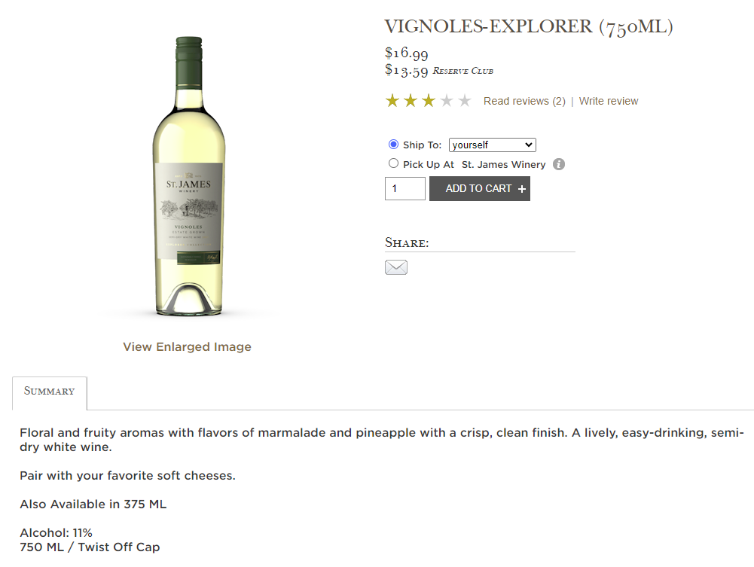
$11

Slide 19
$11

Slide 20
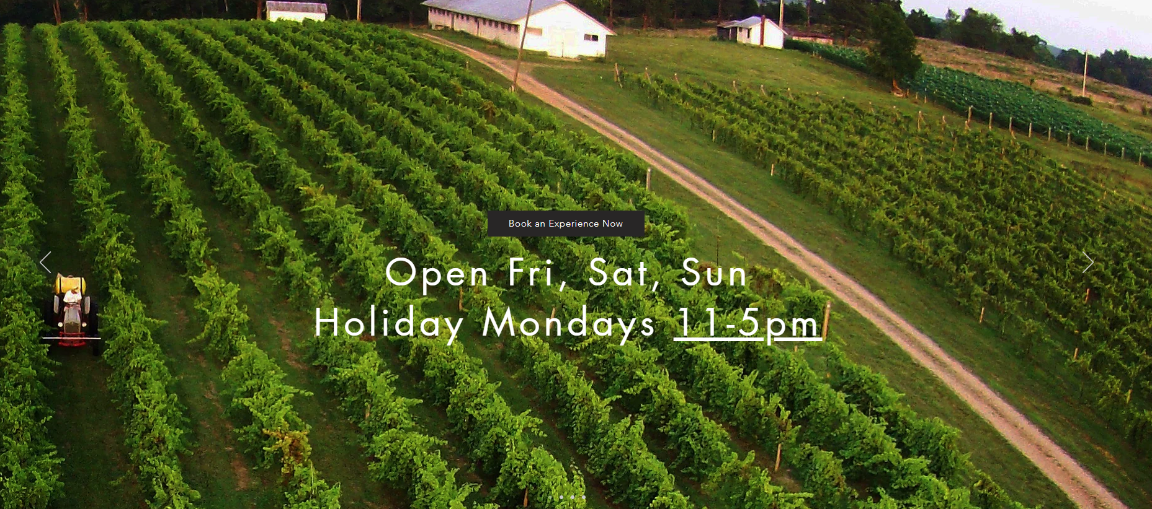

Slide 21
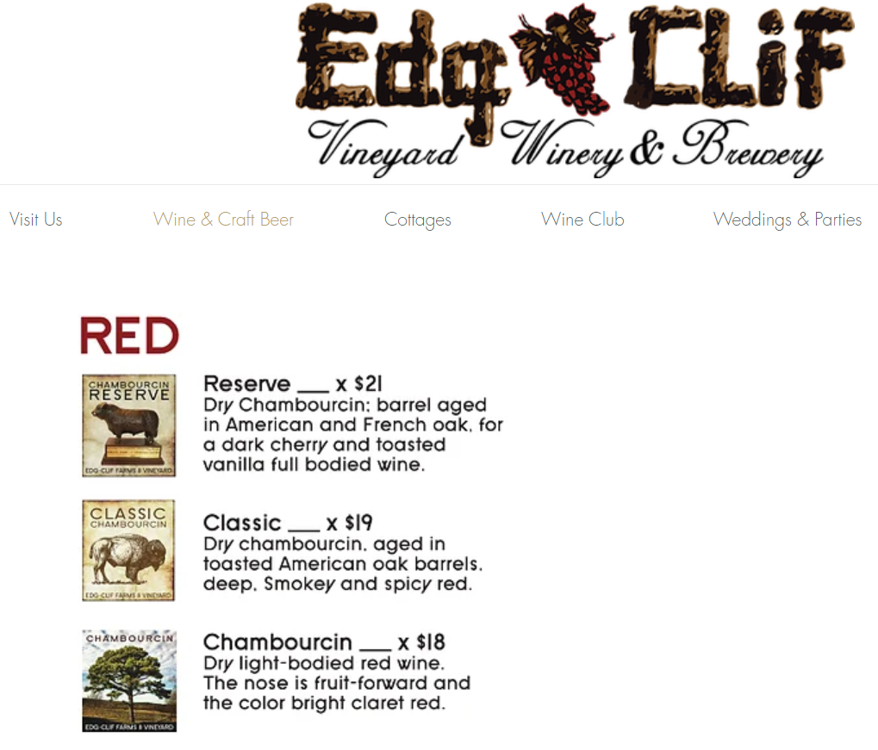
$18

Slide 22
$18

Slide 23
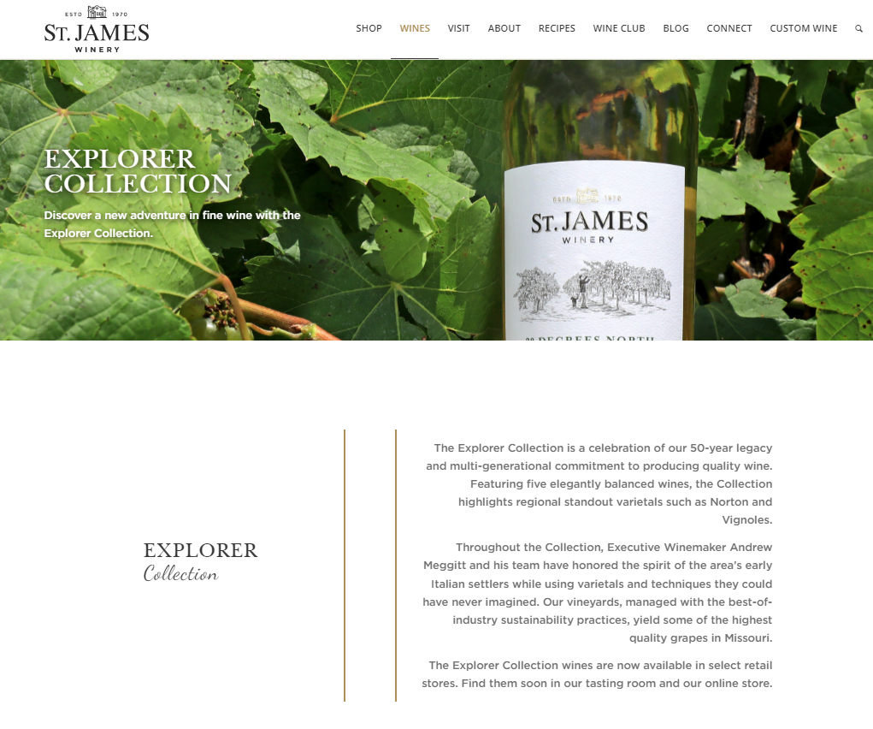

Slide 24
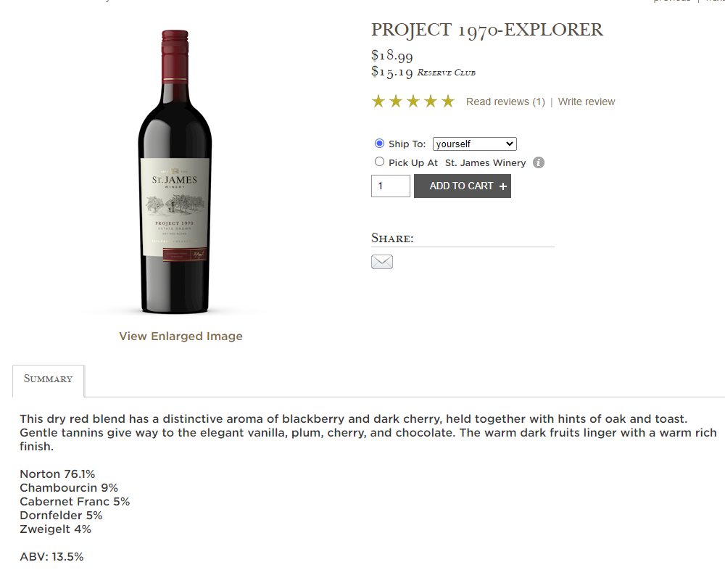
$11

Slide 25
$11

Slide 26
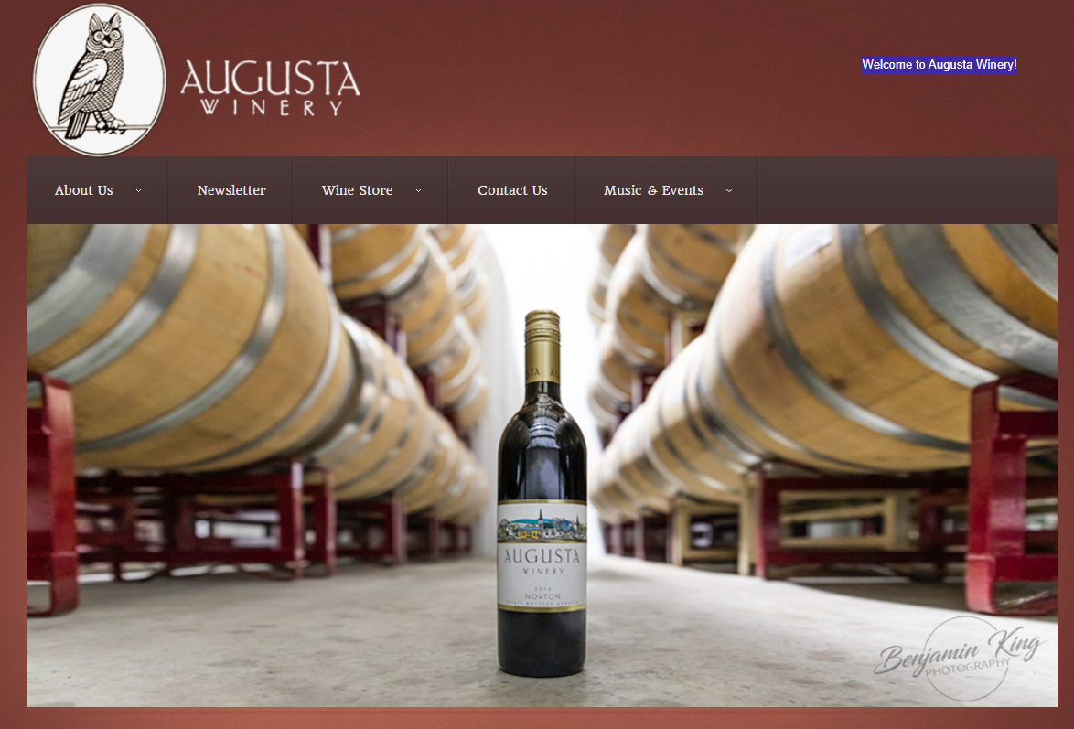

Slide 27
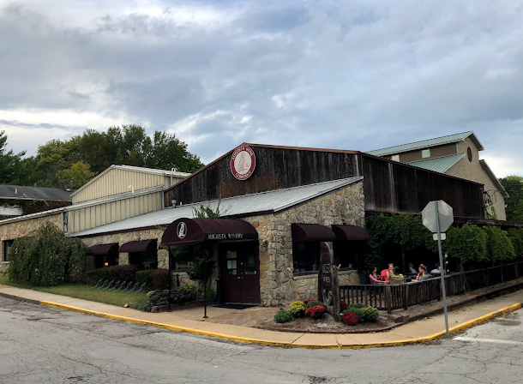
Augusta Winery

Slide 28
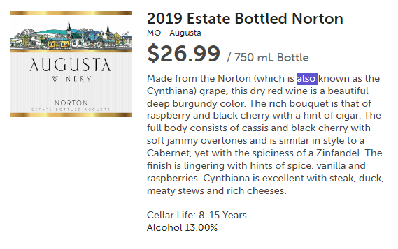
$15

Slide 29
$15

Slide 30
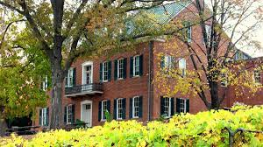
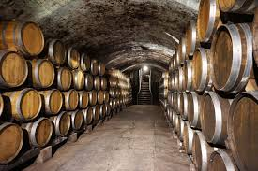
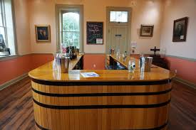
Stone Hill Winery

Slide 31
The winner of the 2023 Governor’s Cup is Stone Hill Winery’s 2020 Old Vine Reserve Norton. The C.V. Riley Award for best Norton went to Stone Hill Winery’s 2020 Old Vine Reserve Norton. The C.V. Riley award recognizes the official state grape and is named after the first state entomologist, who also helped save the French wine industry.
“It’s a great honor to be awarded the 2023 Governor’s Cup, C. V. Riley award and Best of Class Dry Red for our 2020 vintage Old Vine Reserve Norton” says Jon Held, Stone Hill Winery President. “This wine is extremely unique since it’s produced entirely from a pre-prohibition vineyard of Norton vines planted during the 1860’s. This tiny ¼ acre vineyard only yields two to three barrels of wine per year. This precious vineyard was the source of cutting wood for renewed plantings of Norton as the Missouri wine industry was restarting in the 1960’s. It is a special tribute to win with a wine from these old vines since we celebrated the 175th anniversary of Stone Hill Winery last year. As always, our success is due to all the members of our dedicated team whose efforts continue to produce stellar wines year after year.”

Slide 32
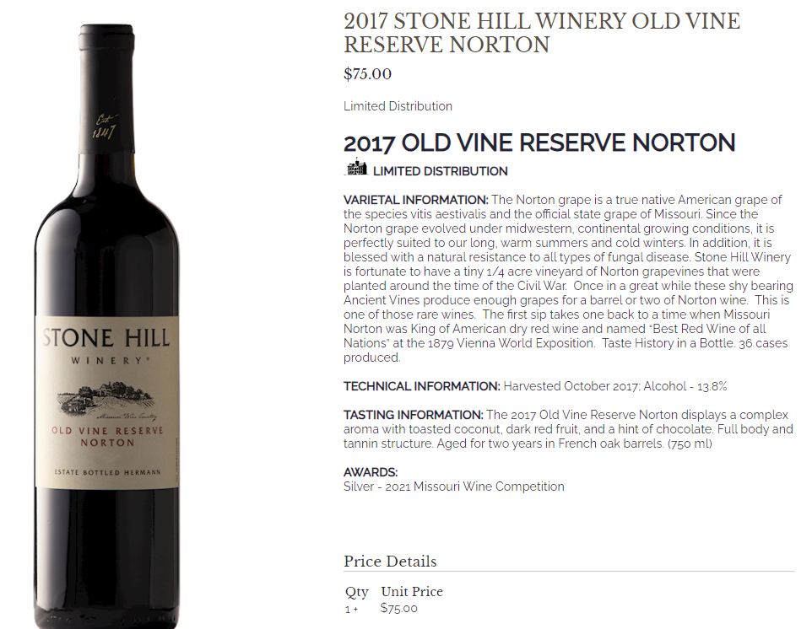
2020
2020

Slide 33
$85

Slide 34
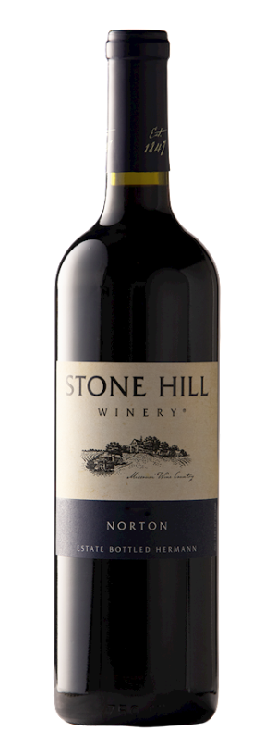
C.V. Riley Award 2022 Competition
VARIETAL INFORMATION: The Norton grape is a true native American grape of the species vitis aestivalis and the official state grape of Missouri. Since the Norton grape evolved under North-American, continental growing conditions, it is perfectly suited to our long, warm summers and cold winters. In addition, it is blessed with a natural resistance to all types of fungal disease. Our Estate Bottled Norton is produced from 100 percent estate-grown Norton grapes from our own Norton Vineyards high above the Missouri River. Careful fermentation on the skins is followed by 12 months of aging in French, Hungarian and American oak barrels.
TASTING INFORMATION: A medium to full bodied red wine with tart cherry, plum preserves and dark chocolate on the palate. Notes of spices, black fruits, savory Greek olives and toasted tobacco. 12 month of barrel aging. Great drinking for now and can easily age another 5-8 years. A.W.S.

Slide 35
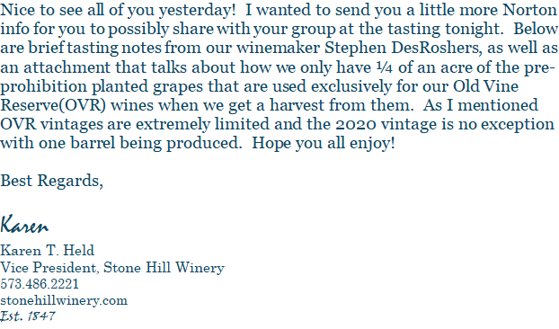

Slide 36
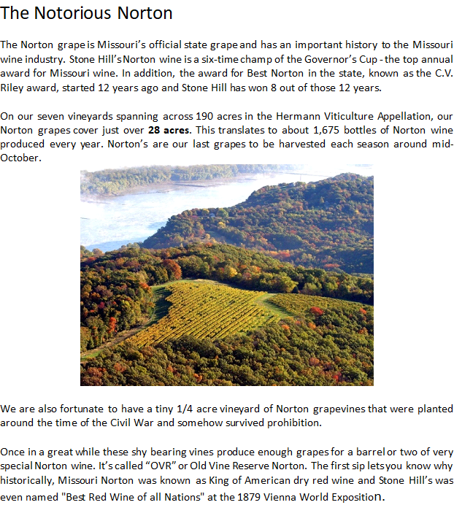

Slide 37
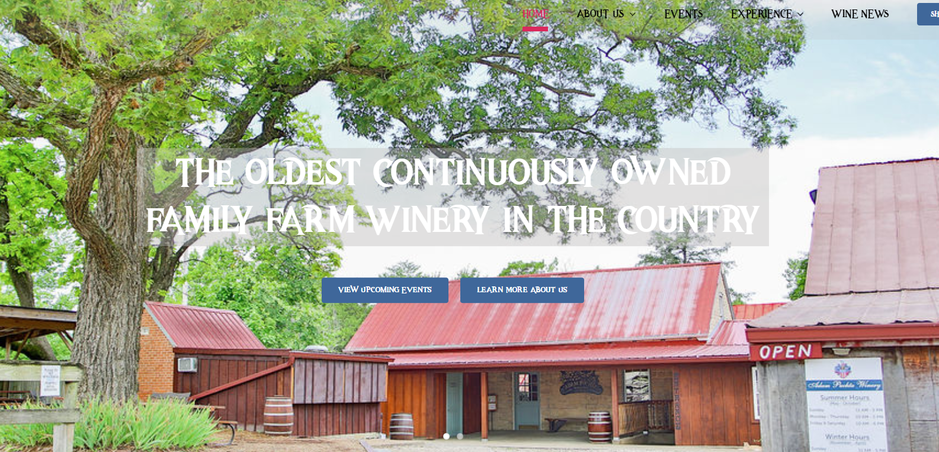

Slide 38
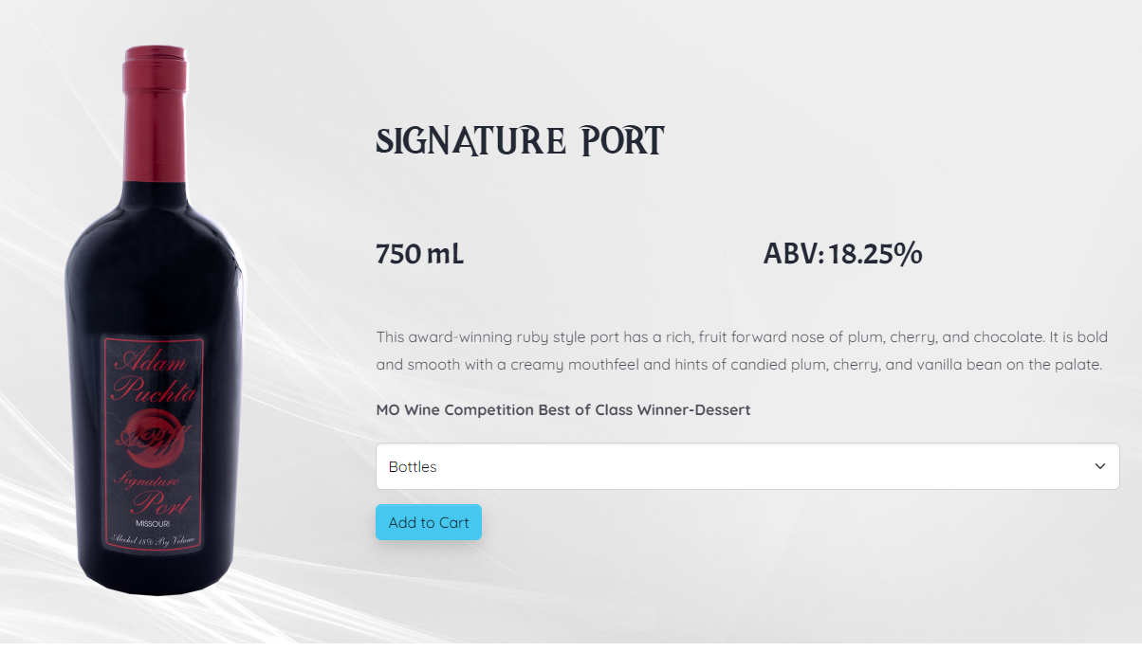
$27

Slide 39
$27

Slide 40
Would You Like to Present Next January?
The MOAu tasting is one of our MWS Traditions
The format is known with some room for creativity
It is fun to research the Gold Medal winners and to find the wines (Friar Tuck & Total Wine & Wineries)
Help is available from the officers
Let Steve B know if you are interested

Slide 41
2022 Missouri Wine Competition
REFERENCE MATERIALS
INFO Not Readily Available for 2023 Competion

Slide 42
2022 Missouri Wine Competition
The Missouri Wine Competition is an elite contest intended to honor and showcase the exceptional wines produced throughout the state. Eight judges blindly tasted 226 wines during the three-day competition.
235 wine representing all regions of Missouri were entered in this esteemed competition.
• 48 Gold Medals, 102 Silver Medals and
70 Bronze Medals were awarded.

Slide 43
2022 Missouri Wine Competition
The Missouri Wine Competition at which Missouri Gold Medal Wines are awarded is a competition created and operated by the Missouri Wine and Grape Board.
The Missouri Wine and Grape Board ( “the Board”) is a Missouri entity created by State Statute.
The Missouri Governor appoints the Board Members.
The Purpose of the Board is to promote the Missouri Wine Industry.
The Board consists of the Board Members and administrative staff. There aren’t members per se but most if not all commercial wineries participates in Board activities.
The Board works with and is affiliated with the University of Missouri Grape and Wine Institute which consists of two divisions : 1) Research and 2) Technical Group
The Board and the institute each have websites and offer a wealth of information to our members.

Slide 44
Missouri Wine Competition
The competition is completed over two days.
Approximately 350 wines are entered.
The Board organizes the wines by Varietal, Style and residual sugar.
Blind Tasting - the judges never see the bottles.
The judges know the Varietal, Style, sugar category and whether blended or not.
Gold medal winners qualify for second day judging for best of class, but a category must have at least 6 entries in order for there to be a Best of Class awarded.
All Best of Class are then tasted side by side, with secret ballots cast for Overall Best.

Slide 45
Mission: “Advance the growth and prosperity of the Missouri grape and wine industry through education and research”
https://gwi.missouri.edu/

Slide 46
Missouri Gold Medal Presentation Winner’s Websites
https://stonehillwinery.com/
https://www.augustawinery.com/
https://www.defianceridgevineyards.com/
https://adampuchtawine.com/
https://missouriwine.org/

